Slide 1
Case Study
Team: Adele Fan, Tony Hsu,
Peter Johnston, Paul Ip

Slide 2
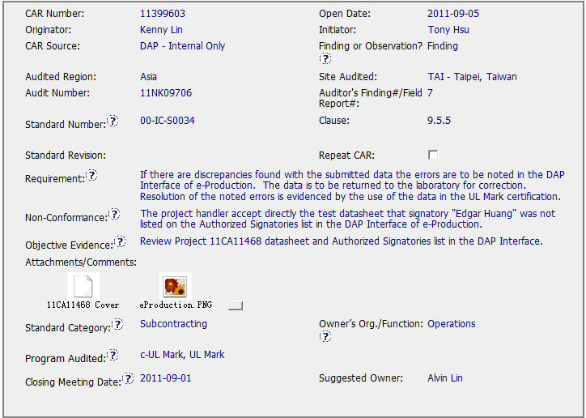
Good CAR – Sample 1
CAR Number: 11399603

Slide 3
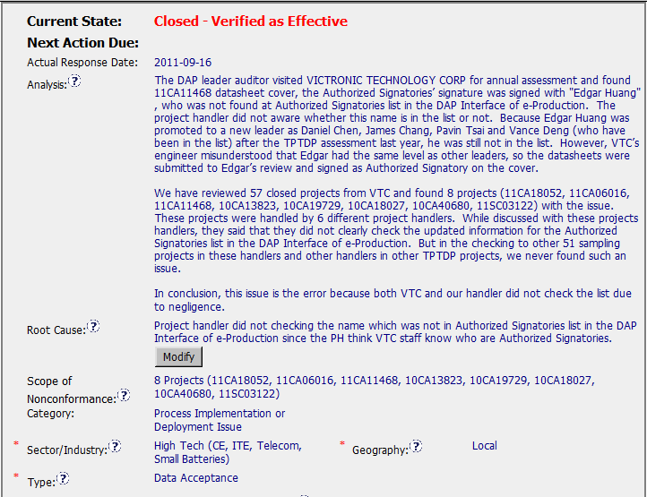
Good CAR – Sample 1
CAR Number: 11399603
[Stakeholder identified, clear path to root cause, with investigation and facts]
[Succinct, reasonable and complete based upon the analysis]

Slide 4
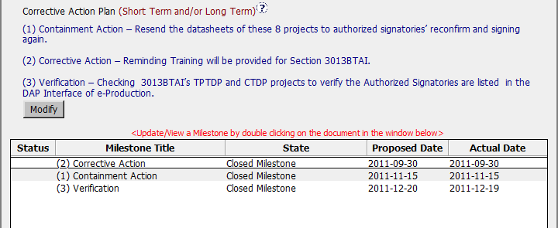
Good CAR – Sample 1
CAR Number: 11399603
[Fix the object evidence]
[Address the root cause]
[Owner verification]

Slide 5
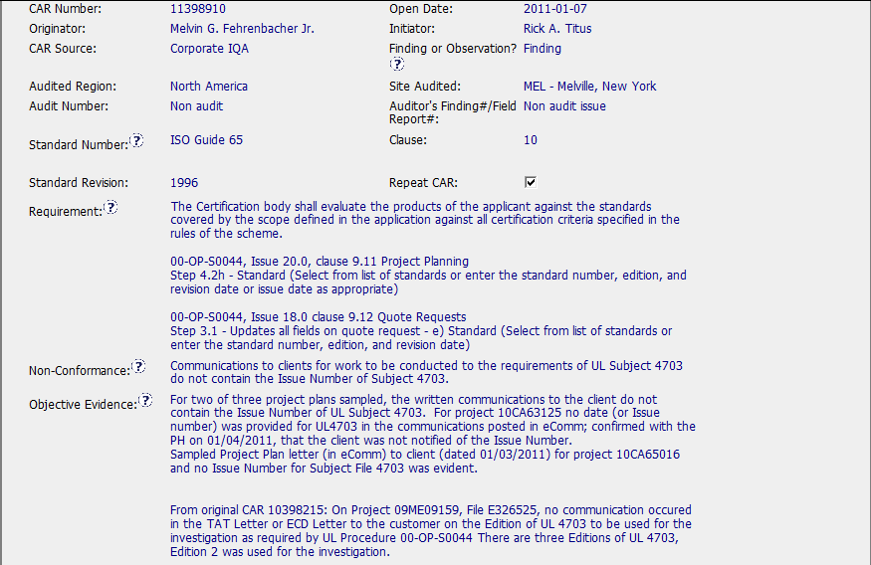
Good CAR – Sample 2
CAR Number: 11398910
[Provided full information in CAR]

Slide 6
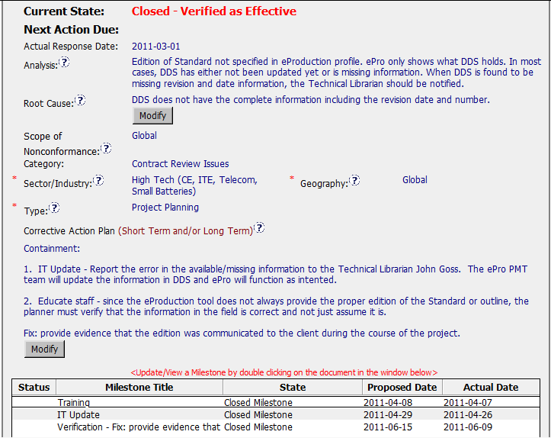
Good CAR – Sample 2
CAR Number: 11398910

Slide 7
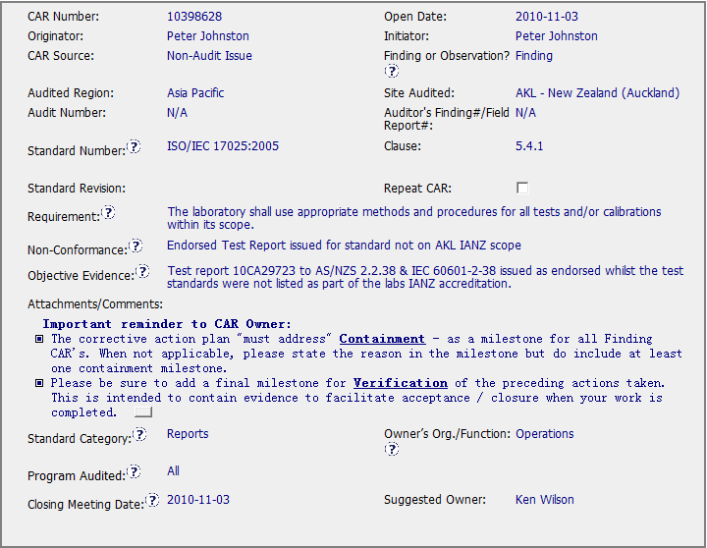
CAR Needing Improvement - Sample 1
CAR Number: 10398628

Slide 8
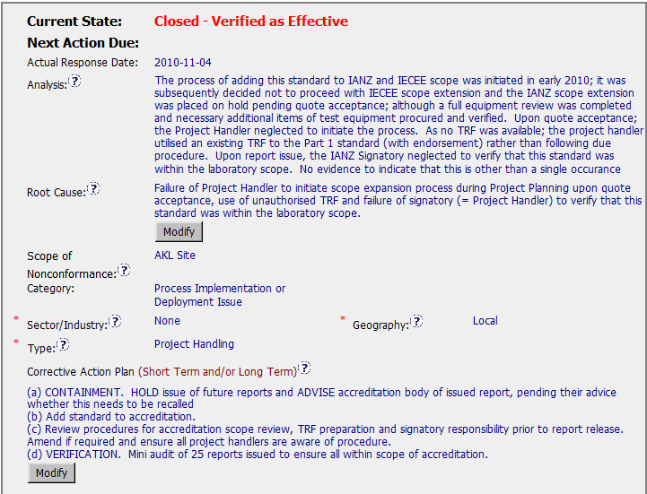
CAR Needing Improvement - Sample 1
CAR Number: 10398628
1

Slide 9
CAR Needing Improvement - Sample 1
CAR Number: 10398628
Concerns:
1. The analysis has a decision statement about the scope of the problem “No evidence to indicate that this is other than a single occurrence” with no analysis to support it. To support this conclusion the analysis should say for example “signatories were interviewed to establish if they routinely checked scope compliance during project review” or “audits of reviewed projects confirmed that signatories routinely check scope compliance during project review”.

Slide 10
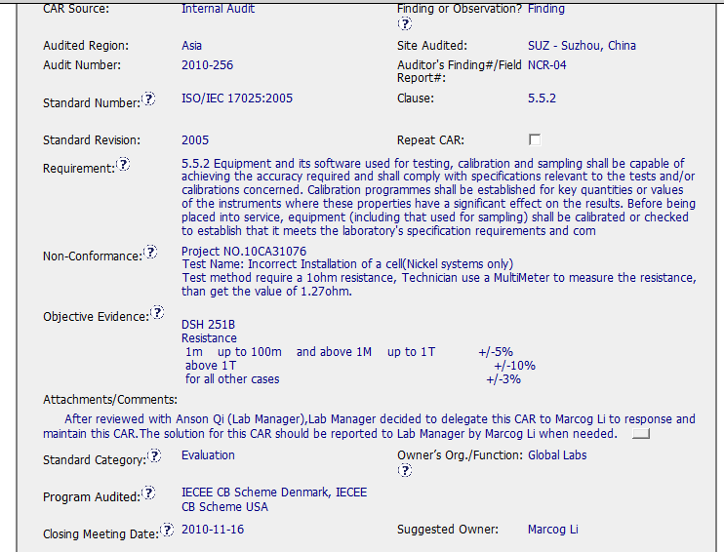
CAR Needing Improvement - Sample 2
CAR Number: 10398706

Slide 11
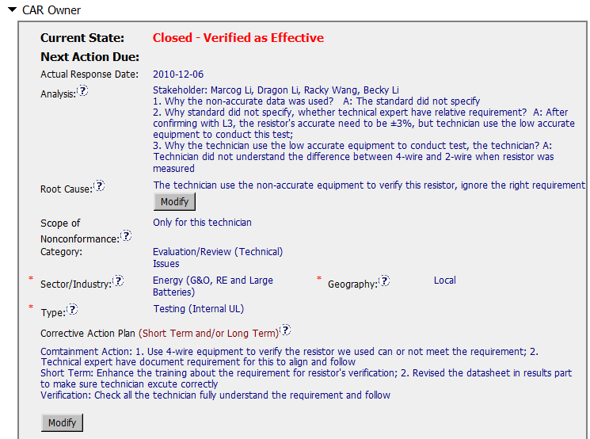
CAR Needing Improvement - Sample 2
CAR Number: 10398706
1
2
3

Slide 12
CAR Needing Improvement - Sample 2
CAR Number: 10398706
Concerns:
1. Lack of the basis for identification of nonconformance scope:
no evidence supporting the investigating for any similar non-conformance case in the local CAS/Lab Team. For example, is there any other projects with this test handled by this technician or by any other technician with the similar problems?
There is no action to invest if any similar non-conformance cases happened
Refer to the concept of containment action, it will be more proper to locate the action “2. Revised the datasheet in results part to make sure technician execute correctly” under Containment Action instead of Short Term

Slide 13
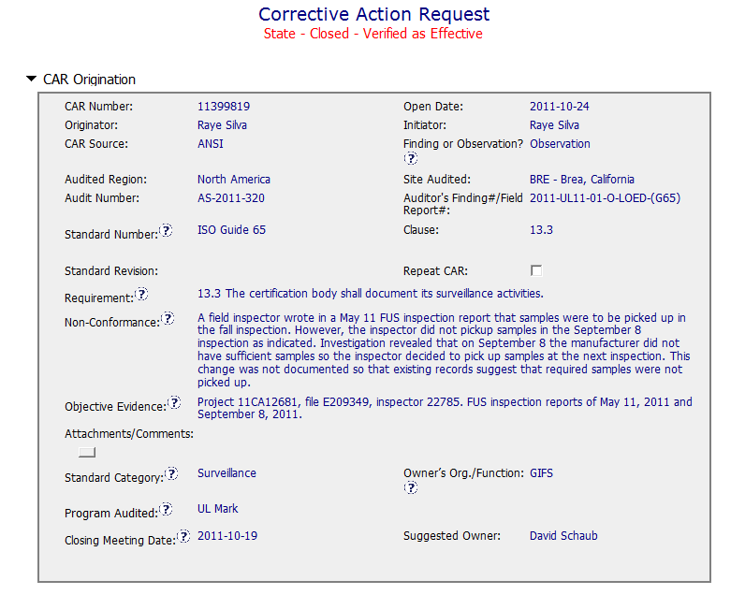
CAR Examples…the Good
Team: Karl Harland,
Jim Kurtz, John Carlin
Concise statement of N/C
? Scope of issue
Factual evidence

Slide 14
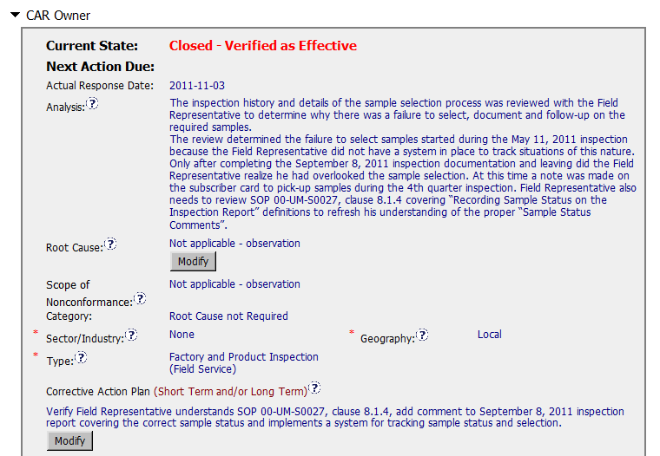
CAR Examples…the Good
Stakeholder identified and involved
Cause identified (no system)
Relevant procedure (requirement identified)
Root Cause N/A as Observation
?
Fix the objective evidence - document
Address analysis items (no system)
? Scope

Slide 15
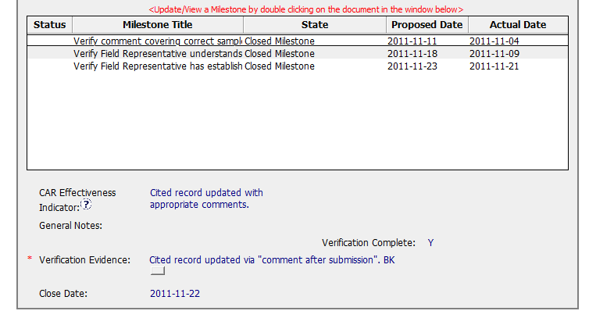
CAR Examples…the Good
Addresses containment
Verifies effectiveness (Understanding and System)

Slide 16
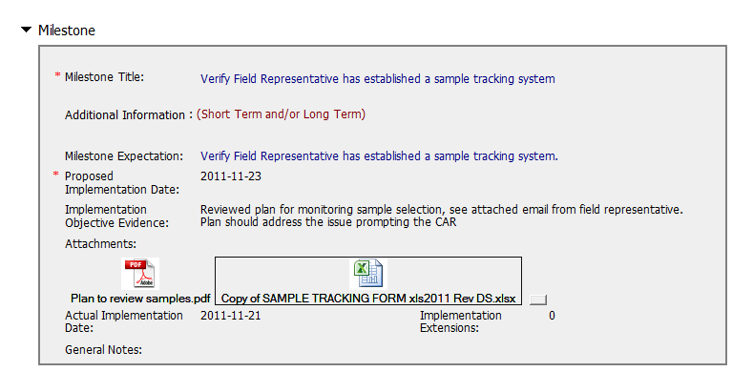
CAR Examples…the Good
Milestones completed as per expectations e.g.
Confirmation from Representative + example tracking template

Slide 17
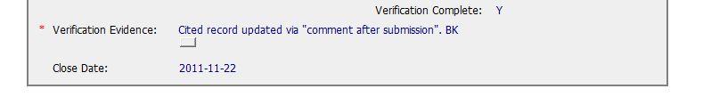
CAR Examples…the Good
Final verification completed immediately

Slide 18
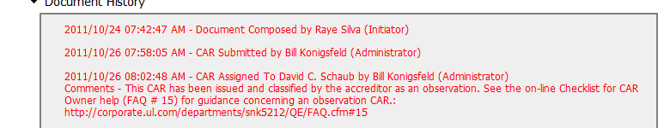
CAR Examples…the Good
Comments added as needed
Extensions n/a – ran to time

Slide 19
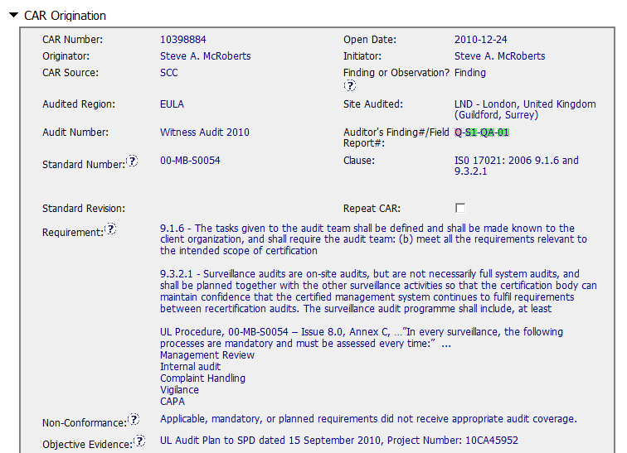
CAR Examples…the not so Good
Non specific n/c
- which elements were omitted ?
Specific evidence

Slide 20
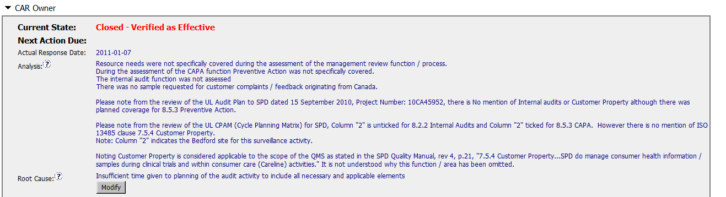
CAR Examples…the not so Good
Omissions identified
Stakeholders not identified and engagement recorded
No clear path to root cause
No documented analysis to determine scope/ geography of the n/c
Questions left unanswered – e.g. Customer Property
Root Cause does not link to the analysis
Correct Root Cause ?

Slide 21
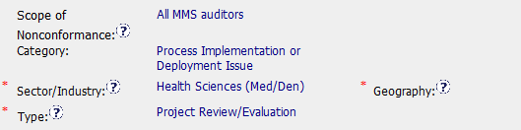
CAR Examples…the not so Good
Category - Based on ?
Type - Evaluation issue

Slide 22
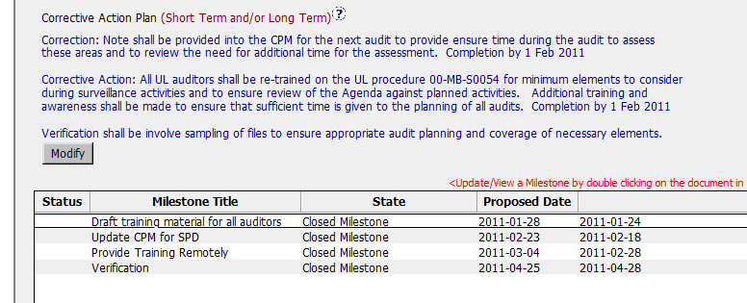
CAR Examples…the not so Good
Fixes objective evidence – MS 2 (not labelled as containment)
Does not address the root cause in full
Verification evidence available
Scope not identified other than Global (no review of previous projects by auditor concerned or others)

Slide 23
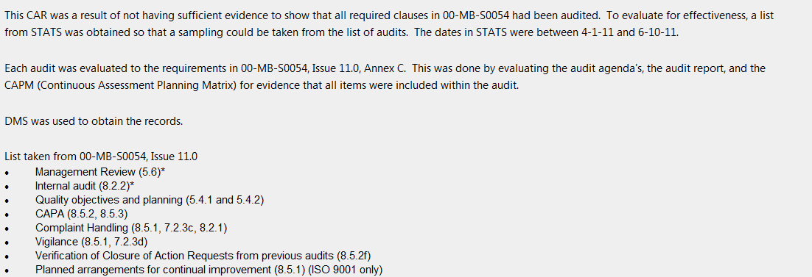
CAR Examples…the not so Good
Timely final Verification evidence available
Supporting comments available
Extension timely (25 days) and rationale recorded

Slide 24
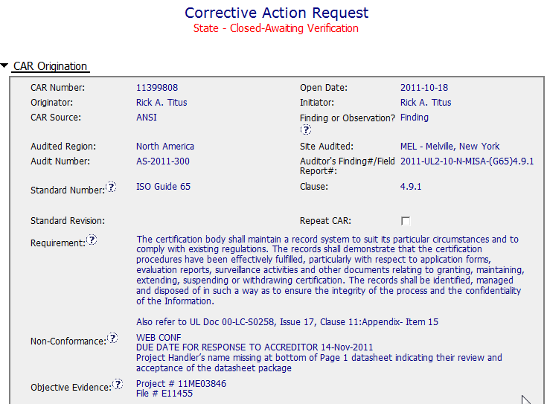
CAR Examples…the Mixed Bag
Clearly stated Requirement
Clear / precise indication of NCR and evidence.

Slide 25
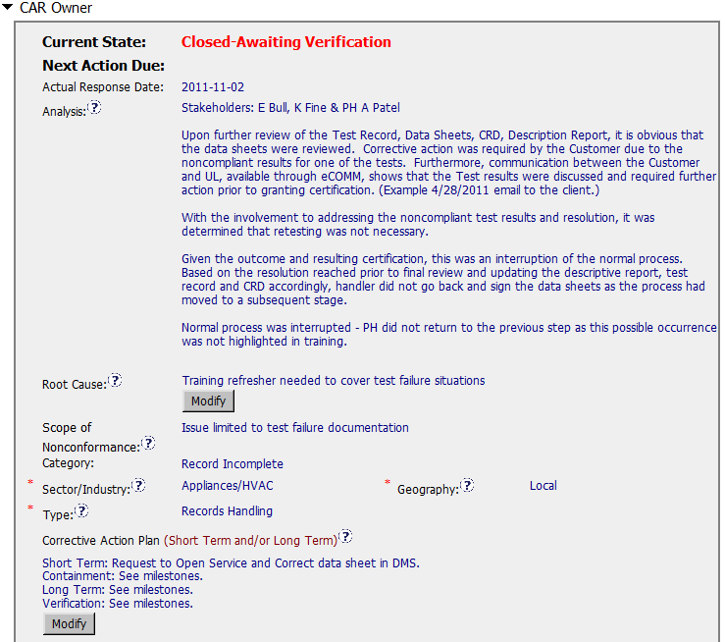
CAR Examples…the Mixed Bag
Clear stakeholder identification
States it’s obvious DS were reviewed but not clear why this is so or why this happened.
Missing linkage to NCR
CAP addressed fixing the item found wrong and included review of other work by handler.

Slide 26
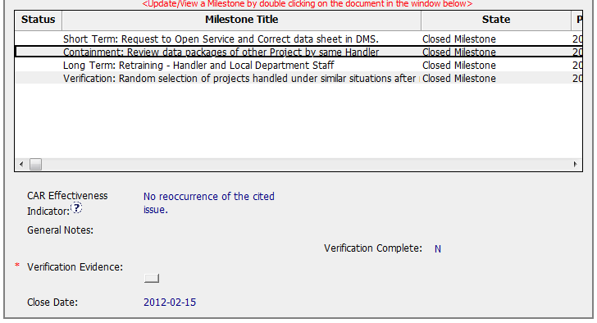
CAR Examples…the Mixed Bag
Addresses containment and verifies effectiveness

Slide 27
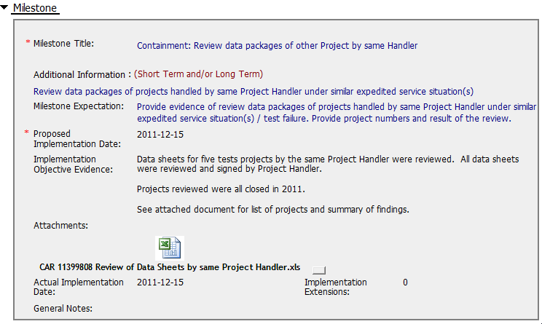
CAR Examples…the Mixed Bag
Typical – milestones completed per plan,
Milestone expectations clearly stated and objective evidence supports successful completion of task.

Slide 28
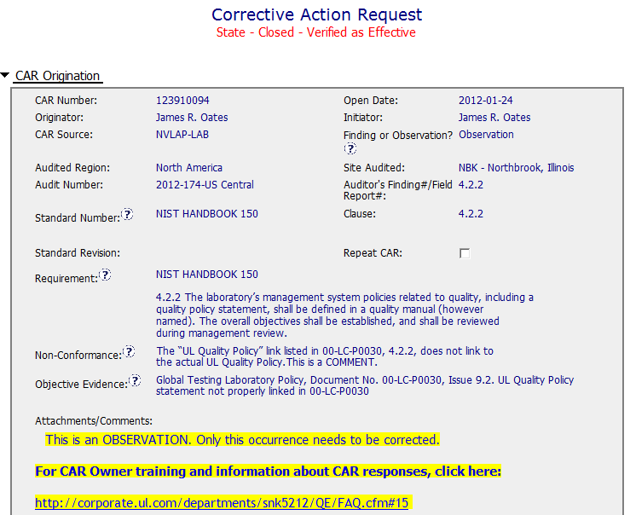
CAR Examples…the Good
Clearly written requirement, NCR and evidence.
Helpful link to FAQ # 15 for Owners reference.

Slide 29
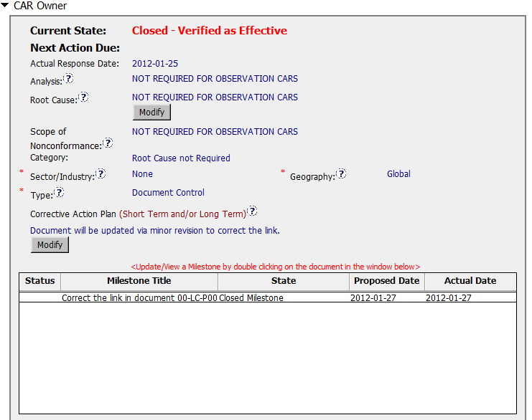
CAR Examples…the Good
Clear that Analysis, RC and Scope are not required for Observation CAR’s
NC Category correctly identified as RC not Required
Milestone correctly repairs what was found defective

Slide 30
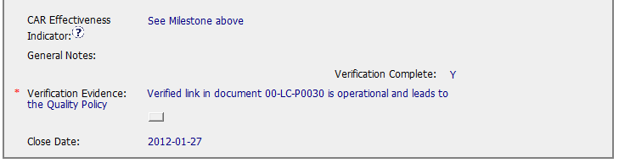

CAR Examples…the Good
Observation verified immediately on closing

Slide 31
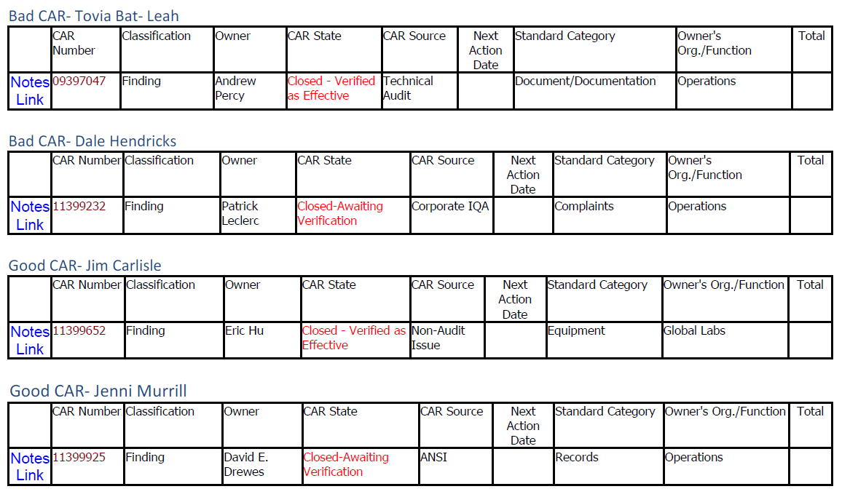
Team: Tovia Bat-Leah, Jim Carlisle,
Dale Hendricks, Jenni Murrill

